Slide 1
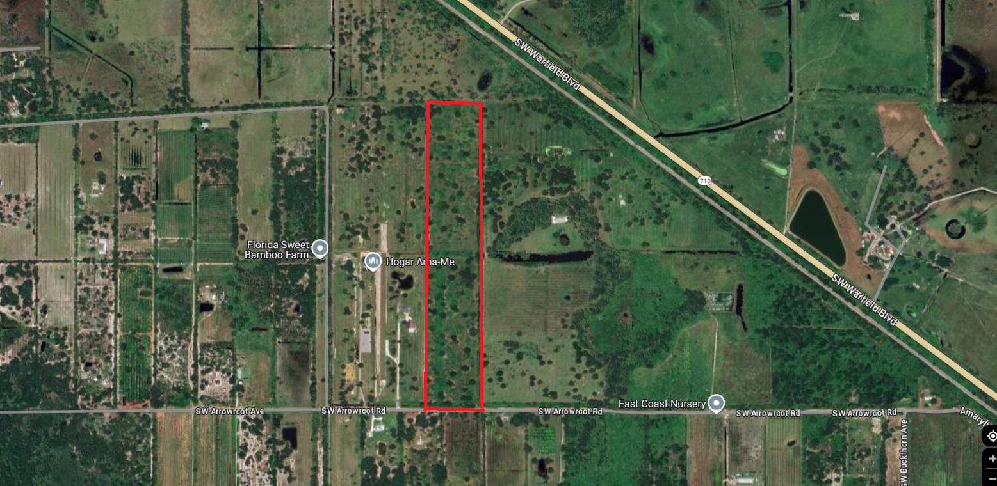
FOR SALE
32.15 Acres
Arrowroot St
indiantown, FL
3500 SW CORPORATE PKWY, SUITE 202
PALM CITY, FL 34990
772 287-4690 - 772 287-9643 (Fax)

Slide 2
PROPERTY INFORMATION
LOCATION: Unassigned: Close to 23401 SW Arrowroot St.
Indiantown, FL 34956
SIZE: 32.15 Acres
ZONING: A-2, Agricultural
TAXES: $
PRICE: $799,999
COMMENTS: 32.15 acres located on Hwy 710 in Martin County. Property is just 6 miles outside of Indiantown
CONTACT: Rick Hartman
The above information has been obtained from sources we consider reliable, but we do not guarantee it; submitted subject to errors, prior sale, withdrawal, or change in price or terms and conditions without notice.

Slide 3
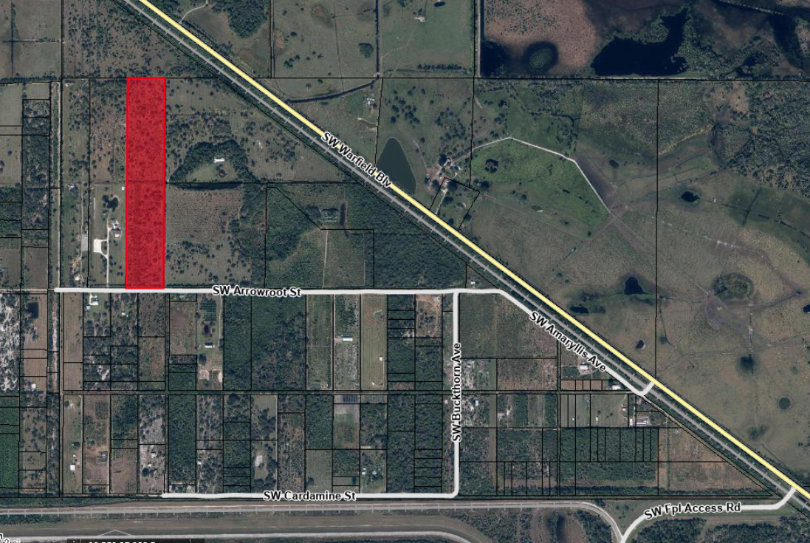
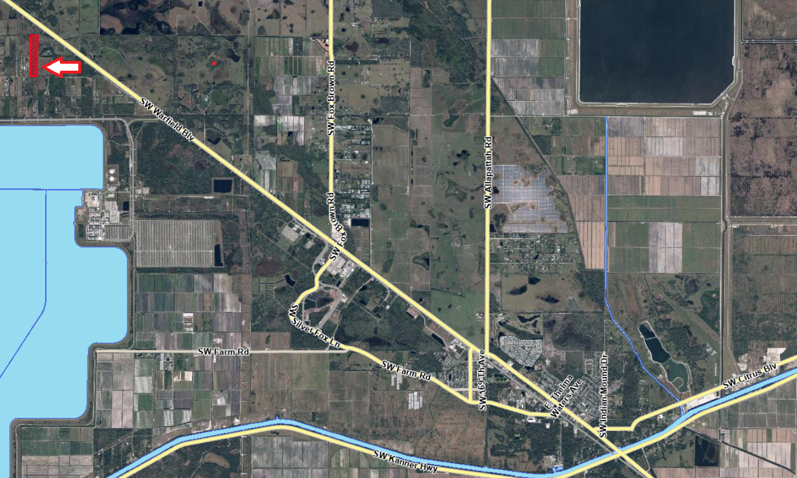

Slide 4
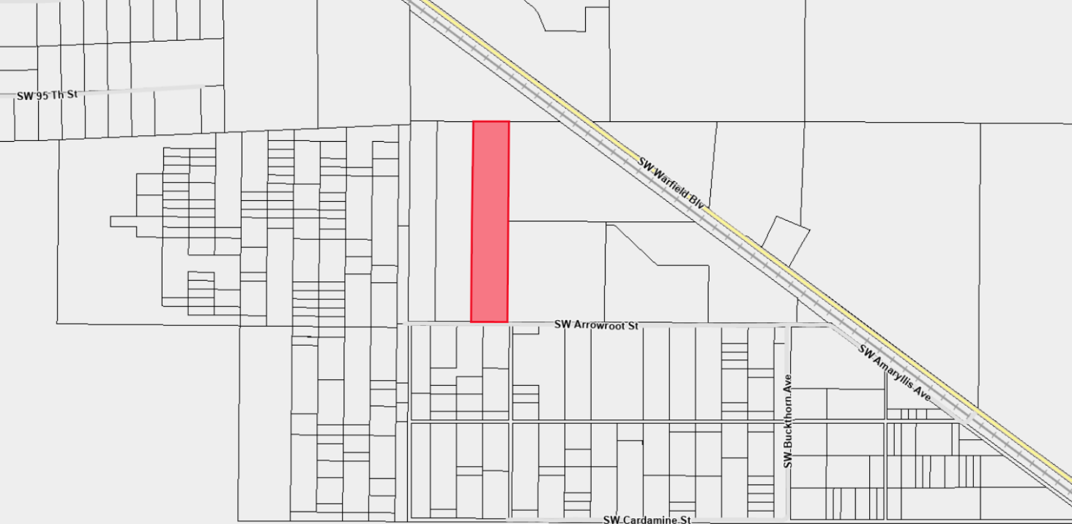
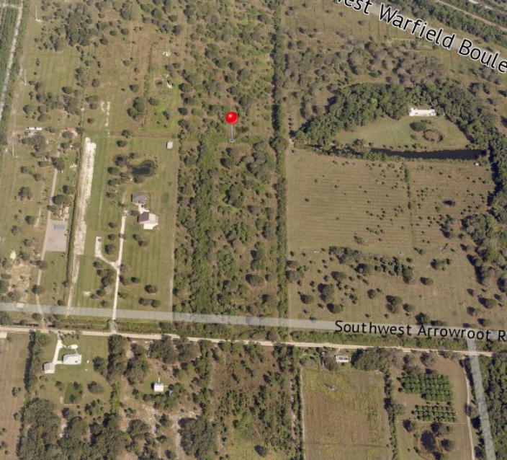

Slide 5
